Slide 1
Uncertainty Analysis on Structural Responses of VAT Laminated Plate
(Title subjected to change)

Slide 2
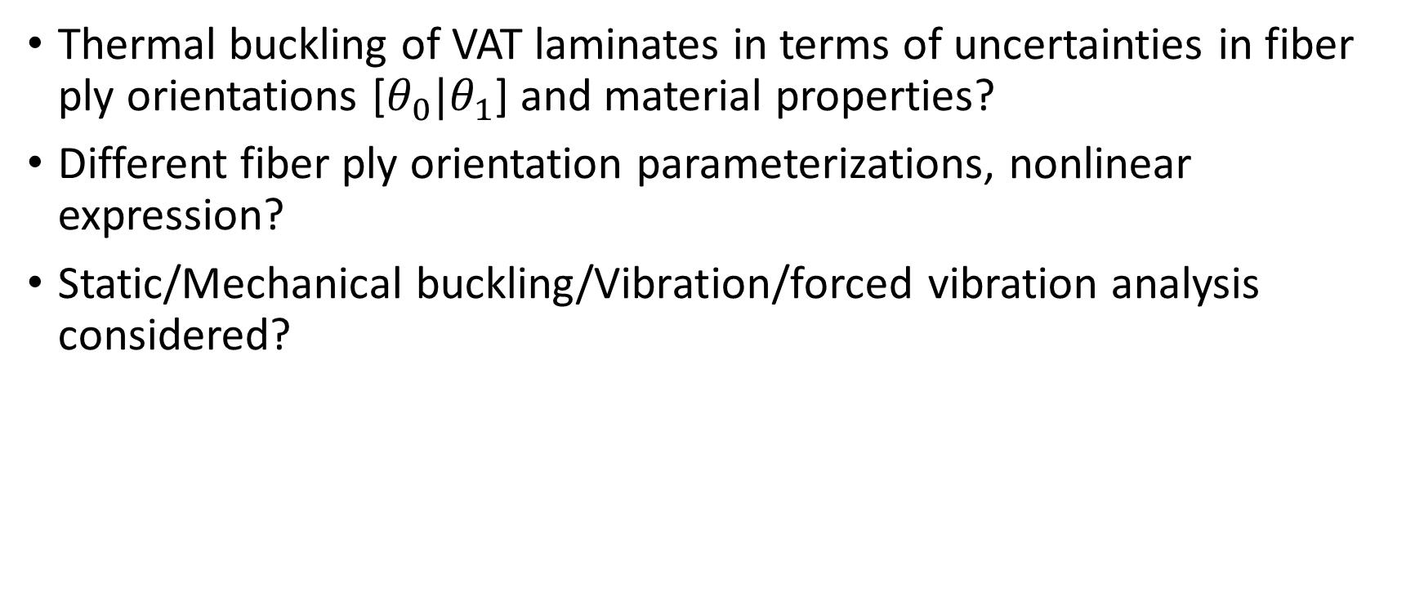
Very Initial Ideas
Thermal buckling of VAT laminates in terms of uncertainties in fiber ply orientations [$θ_{0}|θ_{1}$] and material properties?
Different fiber ply orientation parameterizations, nonlinear expression?
Static/Mechanical buckling/Vibration/forced vibration analysis considered?

